Slide 1
Communication Protocols part 2
Arnab Bhattacharjee
Lecturer, Department of CSE,
United International University
Email id : arnab@cse.uiu.ac.bd
Courtesy: Nasif M. Sir,
Md. Shafqat Talukder Rakin Sir

Slide 2
Serial Communication Protocols
A variety of communication protocols have been developed based on serial communication in the past few decades. Some of them are:
SPI – Serial Peripheral Interface: It is a three-wire based communication system. One wire each for Master to slave and Vice-versa, and one for clock pulses. There is an additional SS (Slave Select) line, which is mostly used when we want to send/receive data between multiple ICs.
I2C – Inter-Integrated Circuit: Pronounced eye-two-see or eye-square-see, this is an advanced form of USART. The transmission speeds can be as high as a whopping 400KHz. The I2C bus has two wires – one for clock, and the other is the data line, which is bi-directional. It is invented by Philips.

Slide 3
Serial Communication Protocols
Ethernet: Used mostly in LAN connections, the bus consists of 8 lines, or 4 Tx/Rx pairs.
Universal serial bus (USB): This is the most popular of all. Is used for virtually all type of connections. The bus has 4 lines: V_{CC}, Ground, Data+, and Data-.
RS-232 – Recommended Standard 232: The RS-232 is typically connected using a DB9 connector, which has 9 pins, out of which 5 are input, 3 are output, and one is Ground. You can still find this so-called “Serial” port in some old PCs. In our upcoming posts, we will discuss mainly about RS232 and USART of AVR microcontrollers.

Slide 4
Serial Peripheral Interface (SPI)
Serial Peripheral Interface (SPI) is a synchronous serial data protocol used by microcontrollers for communicating with one or more peripheral devices quickly over short distances. It can also be used for communication between two microcontrollers.
With an SPI connection there is always one master device (usually a microcontroller) which controls the peripheral devices. Typically there are three lines common to all the devices:
MISO (Master In Slave Out) - The Slave line for sending data to the master,
MOSI (Master Out Slave In) - The Master line for sending data to the peripherals,
SCK (Serial Clock) - The clock pulses which synchronize data transmission generated by the master and one line specific for every device:
SS (Slave Select/ Chip select) - the pin on each device that the master can use to enable and disable specific devices.

Slide 5
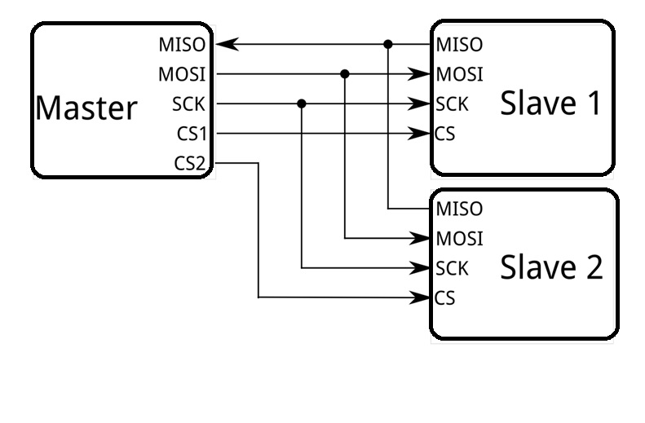
Serial Peripheral Interface (SPI)
Figure: SPI communication protocol

Slide 6
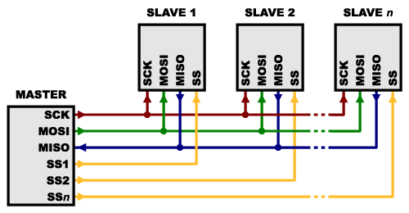
Serial Peripheral Interface (SPI)
Figure : Multiple slaves are connected with master using SPI protocol

Slide 7
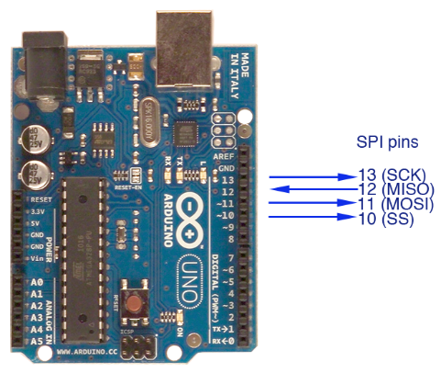

Slide 8
Advantages of SPI
The receiver/sender hardware can be a simple shift register
It supports multiple slaves
Disadvantages of SPI
The master must control all communications (slaves can’t talk directly to each other)
It usually requires separate SS lines to each slave, which can be problematic if numerous slaves are needed

Slide 9
I2C Protocol
The Inter-integrated Circuit (I²C) Protocol is a protocol intended to allow multiple “slave” digital integrated circuits (“chips”) to communicate with one or more “master” chips. Like the Serial Peripheral Interface (SPI), it is only intended for short distance communications within a single device. Like Asynchronous Serial Interfaces (such as RS-232 or UARTs), it only requires two signal wires to exchange information.
I²C requires a mere two wires, like asynchronous serial, but those two wires can support up to 1008 slave devices. Also, unlike SPI, I²C can support a multi-master system, allowing more than one master to communicate with all devices on the bus (although the master devices can’t talk to each other over the bus and must take turns using the bus lines).
I2C specifies 2 address lengths, 7 and 10 bits, which gives a theoretical maximum of 128 and 1024 distinct address, respectively. However, there are a few reserved addresses, such as 0x00 (general call). This further limits the address space.

Slide 10
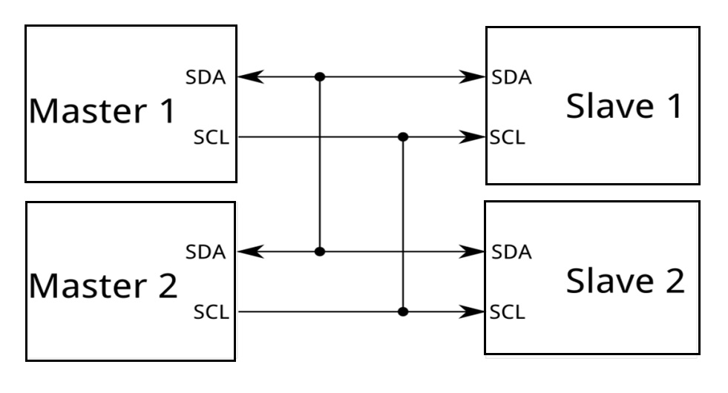
I2C Protocol
The I2C protocol involves using two lines to send and receive data: a serial clock pin (SCL) and a serial data pin (SDA) over which data is sent between the two devices.
Figure: I2C Protocol

Slide 11
Advantages of I2C
1. Flexibility – The I2C protocol supports multi-master, multi-slave communication. More than one master IC controlling and communicating with the slave ICs can speed things up and add more functionalities to the embedded system.
2. Addressing feature –Another advantage of the I2C protocol lies in its inherent ability to use chip addressing. It means that it is possible to add components to the bus without any complexity. It eliminates the necessity of CS (chip select) lines.
3. Simplicity – I2C protocol doesn’t complicate the design. It requires only two bidirectional signal lines to establish communication among multiple devices.
4. Reliable Data Transfer - ACK/NACK bit gives confirmation that each frame is transferred successfully

Slide 12
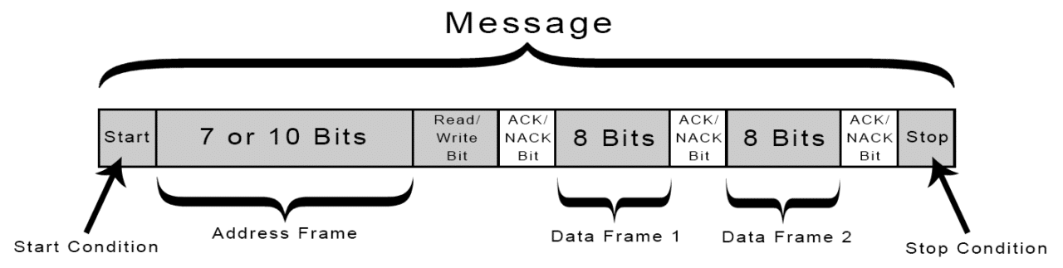
How I2C works
With I2C, data is transferred in messages. Messages are broken up into frames of data. Each message has an address frame that contains the binary address of the slave, and one or more data frames that contain the data being transmitted. The message also includes start and stop conditions, read/write bits, and ACK/NACK bits between each data frame:
Figure: Instruction sequence data from master to slave

Slide 13
Handshaking Process in I2C Protocol
In I2C for each byte, an acknowledgment needs to be sent by the receiver, this acknowledgment bit is a proof that data is properly received by the receiver and it wants to continue the communication.
A master starts the communication to assert a start condition on the bus. After the start condition master is transmitted a 10-bit address with associated a read or write bits.
After the transmission of the address byte, master release the data lines, which allows the receiver (slave) to give the acknowledgment.
Each slave compares the address sent from the master to its own address. If the address matches, the slave returns an ACK bit.
After receiving the Acknowledgment bit, Master continue the read or write operation.

Slide 14
Handshaking Process in I2C Protocol - Acknowledge (ACK) and Not Acknowledge (NACK)
Some scenario, where NACK bit is generated-
When the receiver is unable to receive, in that situation it generates a NACK bit to stop the communication.
During the communication, if the receiver gets any data or commands which are not understood by the receiver then it generates a NACK bit.
When Master is a receiver and reads the data from the slave, then after the reading of whole data it asserts a NACK bit on data lines to stop the communication.
If there is no device present in the I2C bus of the same address which is transmitted by the master, then the master will not get the acknowledge by any slave and treat this situation as NACK.

Slide 15
I2C WRITE operation
In I2C before the performing, the WRITE operation master has to assert a start condition on I2C bus with the slave’s address and write control bit (for write operation control bit will be 0).
If the transmitted address match with any slave which connected to the I2C bus then master receives an acknowledge (ACK) bit. After getting the ACK bit master send the address of the register, where it wishes to write, the slave will acknowledge again, letting the master know it is ready for the WRITE operation.
After getting this acknowledgment, the master will start sending the data to the slave. Master will get the acknowledgment of each transmitted byte of data.
When the master has sent all the data then the master end the transmission with a STOP condition.

Slide 16
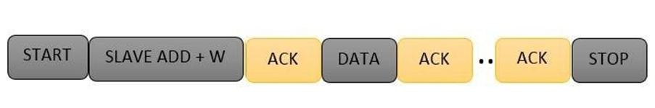
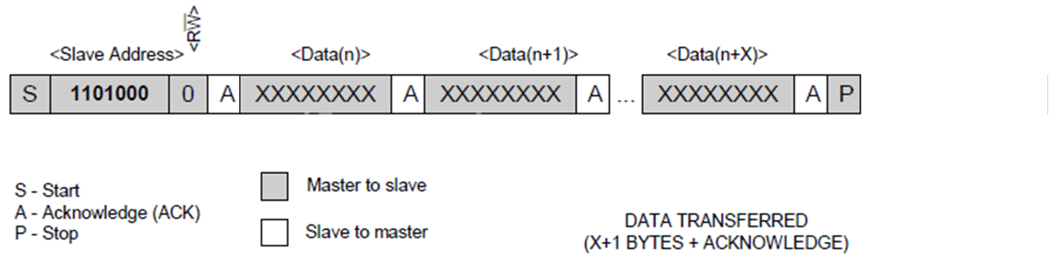
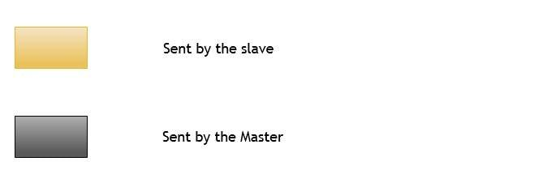
I2C WRITE operation

Slide 17
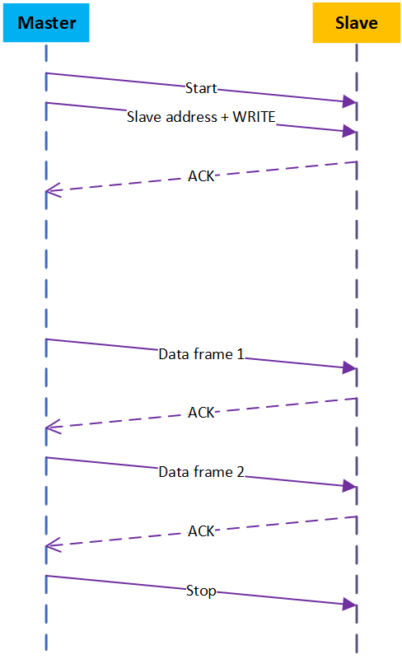
Figure: Sequence diagram showing Master to slave WRITE operation
(send 2 data frame)

Slide 18
I2C READ operation
Here, master asserts the start condition before the READ operation. After the start condition master transmit the slave address with READ control bit (for read operation control bit will be 1), if the transmitted address match with any device in the I2C bus then it acknowledges to the master.
After getting ACK bit, master release the data bus but continue sending the clock pulse, in that situation master become receiver and slave become the transmitter.
In the READ operation, the master gives the acknowledgment to the slave on the receiving of every byte of data to let the slave know that it is ready for more data. Once the master has received the number of bytes which it is expecting, it will send a NACK bit to release the BUS and send the STOP condition to halt the communication.

Slide 19
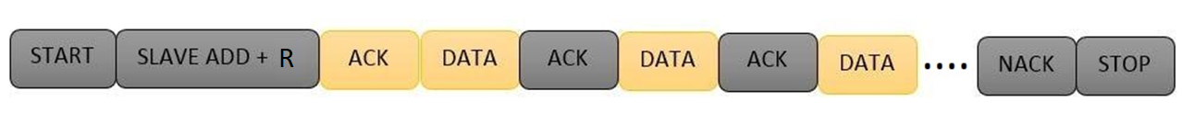
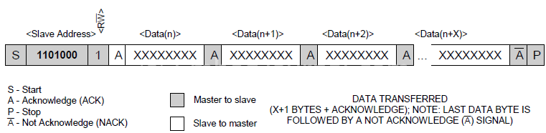
I2C READ operation

Slide 20
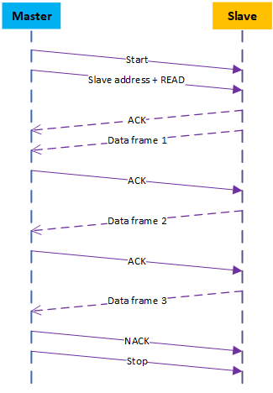
Figure: Sequence diagram showing Master to slave READ operation
(Receive 3 data frame)

Slide 21
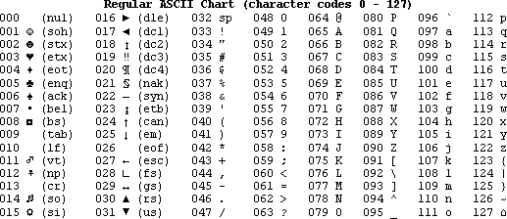
Exercise: Master (index:2H) send data (char ‘hat’) to the slave (index:8H). Draw the corresponding sequence diagram.
Decimal ASCII Chart
Decimal ASCII Chart

Slide 22
Exercise: Master (index:3H) receive 5 byte data (char ‘water’) from the slave (index:9H). Draw the corresponding sequence diagram.
Decimal ASCII Chart

Slide 23
I2C disadvantage
Slower data transfer rate than SPI
The size of the data frame is limited to 8 bits

Slide 24
I2C Q and A
Can masters talk to each other in a I2C BUS?
No.
Only one master can be active at once - this means that a master can only talk to slaves and slaves can appropriately reply. To have a multi-master scenario, there has to be relinquishment of master status by one device and acceptance of master status by another device.
Can slave talk to each other in a I2C BUS?
No.

Slide 25
I2C Q and A
Can multiple master talk to the slaves simultaneously?
For normal data transfer on the I2C bus only one master can be active. If for some reason two masters initiate I2C command at the same time, in such case each device needs to be able to cooperate with the fact that another device is currently talking and the bus is therefore busy. There two techniques available:
a) Arbitration logic. If two devices start to communicate at the same time the one writing more zeros to the bus wins the arbitration and the other device immediately discontinues any operation on the bus.
b) Bus busy detection. Each device must detect an ongoing bus communication and must not interrupt it. This is achieved by recognizing traffic and waiting for a stop condition to appear before starting to talk on the bus.
The winning master will control both data bus and clock.

Slide 26
Reference
http://www.circuitbasics.com/basics-of-the-i2c-communication-protocol/
https://aticleworld.com/i2c-bus-protocol-and-interface/

Slide 27
Master
Slave
START
0001001+1
ACK
01001000(H)
Exercise: Master (index:3H) receive 4 byte data (char ‘Hell’) from the slave (index:9H). Draw the corresponding sequence diagram.
ACK
01100101(e)
ACK
01101100 (l)
ACK
01101100 (l)
NACK
STOP

Slide 28
Master
Slave
START
0000010101+1
ACK
01001000(H)
Exercise: Master (index:3H) receive 2 byte data (char ‘Hi’) from the slave (index:15H). Draw the corresponding sequence diagram.
ACK
01101001 (i)
NACK
STOP

Slide 29
Thank You

